Slide 1
Chesapeake Bay Program Climate Change Modeling
Gary Shenk USGS-CBPO
Gopal Bhatt PSU, Lewis Linker EPA, Richard Tian UMCES …and the whole team
ICPRB and DEQ
2/7/2019

Slide 2
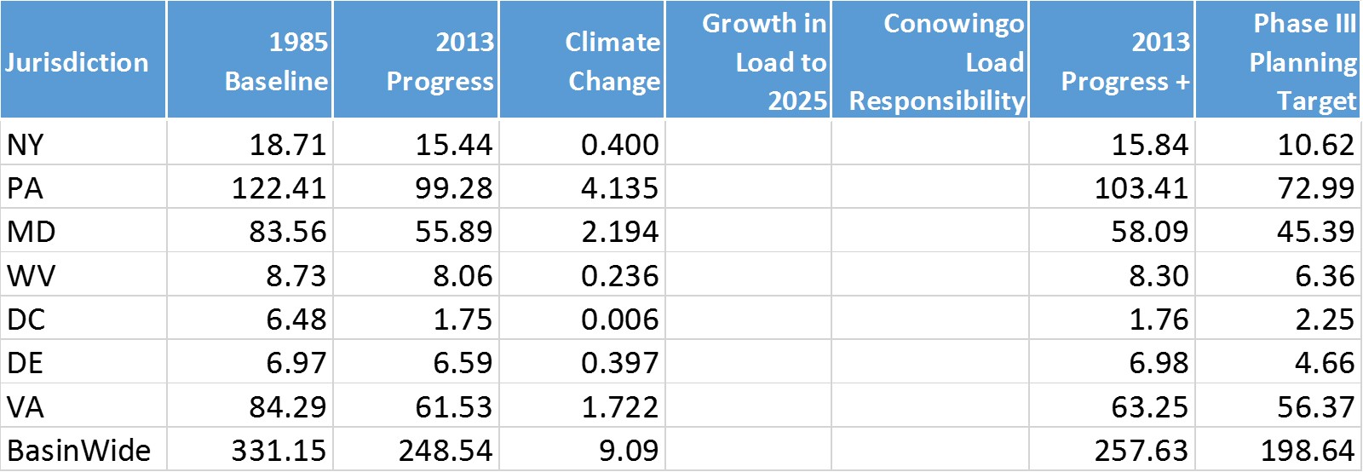
Climate Change Loads: Nitrogen
December 2017
*Units: millions of pounds

Slide 3
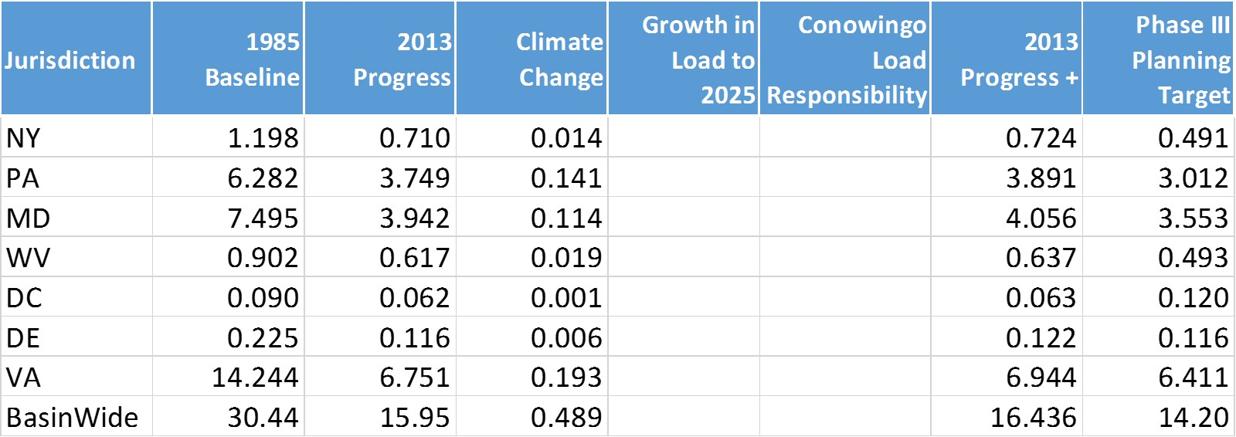
Climate Change Loads: Phosphorus
December 2017
*Units: millions of pounds

Slide 4
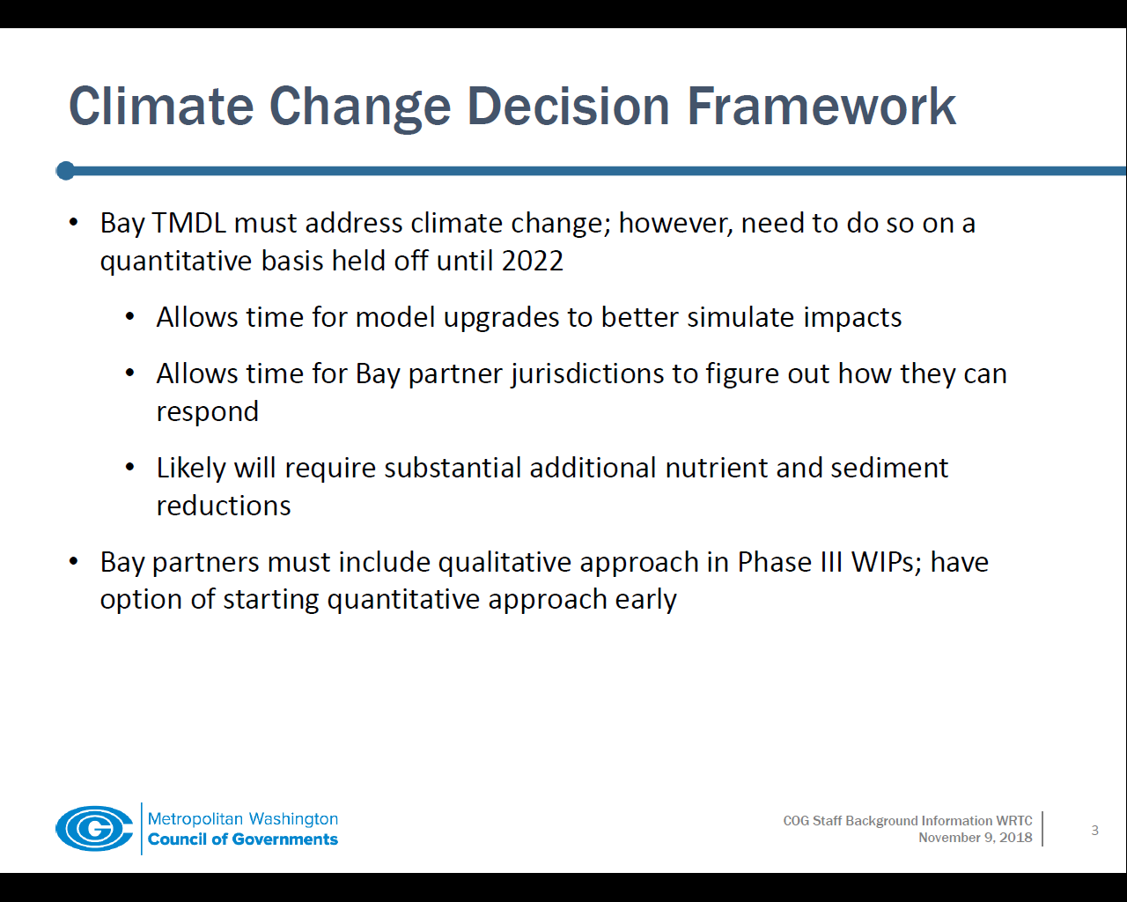

Slide 5
CBP Climate Work Plan
2018
STAC Workshop
2019
Water Quality GIT, Modeling WG, Climate Resiliency WQ direct Modeling team to develop climate change assessment for TMDL
2020
Technical Review of Models
2021
Climate change considerations will be implemented into the 2022-2023 milestones.
Jurisdictions provide narrative in WIP3s on climate strategies
Modeling WG develop climate scenarios
Climate Resiliency WG to investigate BMP response
Notes:
See Attachment 1 in your materials
Arrow indicates where we are today
Circle show a key deliverable, the revised assessment.

Slide 6
1995
2005
2015
2025
2035
2045
2055
2017 climate change assessment
1995
2005
2015
2025
2035
2045
2055
2019 climate change assessment
2065

Slide 7
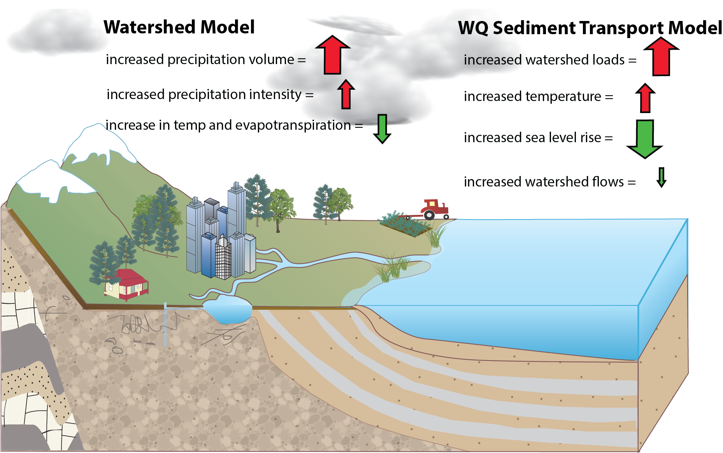
Accounting for Changing Conditions Cumulative Assessment of Bay Low Dissolved Oxygen Impacts

Slide 8
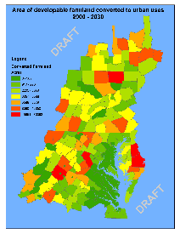
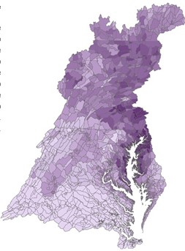
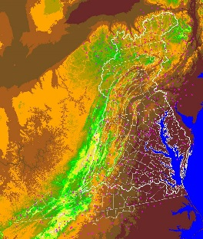
CBP Decision Support System
Bay
Model
Criteria
Assessment
Procedures
Land Use
Change Model
Watershed
Model
Data
Airshed
Model
Effects
Allocations

Slide 9
CBP Climate Analysis System
Scenario selection
GCM Selection Process
Downscaling Method
Observed Trends
Creation of future climate scenarios
Human responses to climate change
Process-based response of flow and sediment
Specified response to flow and sediment
Estuarine Process-based model
Effect on water quality standards
Management Effort Adjustment

Slide 10




CBP Climate Analysis System
Scenario selection
GCM Selection Process
Downscaling Method
Downscaling Method
Observed Trends
Creation of future climate scenarios
2016 STAC workshop The Development of Climate Projections for Use in Chesapeake Bay Program Assessments (Johnson et al. 2016).
2025: Use long-term observed trends for precipitation
2050 precipitation and all temperature: Use an ensemble of existing downscaling of CMIP5 models
Carefully consider evapotranspiration
Use RCP 2.6, 4.5, and 8.5

Slide 11
2019 Assessment
Year
2025
2035
2045
2050
Precipitation
Trend | Ensemble
STAC/CR | –
MWG | interpolate
MWG | interpolate
– | STAC/CR
Temperature
Trend | Ensemble
– | STAC/CR
? | MWG
? | MWG
– | STAC/CR
Selections highlighted in yellow are the STAC and CBP climate resiliency workgroup recommendations and CBP approved approaches for the 2017 Climate Change assessment.
For 2035 and 2045 the Modeling Workgroup (September 2018) recommended (a) combining the two sources using weighted means for rainfall, (b) using the ensemble for temperature.

Slide 12
CBP Climate Analysis System
RCP selection
GCM Selection Process
Downscaling Method
Downscaling Method
Observed Trends
Creation of future climate scenarios
Observed Precipitation Trends
1927-2014 PRISM precipitation data
Aggregated to annual values of a county
Ordinary least squares regression to determine slope
30 years of slope applied to each month of 1991-2000 rainfall data

Slide 13
CBP Climate Analysis System
RCP selection
GCM Selection Process
Downscaling Method
Downscaling Method
Observed Trends
Creation of future climate scenarios
Used RCP 4.5 for scenario run through the full modeling system and shown to PSC
Found significant overlap with RCP 2.6 and 8.5

Slide 14
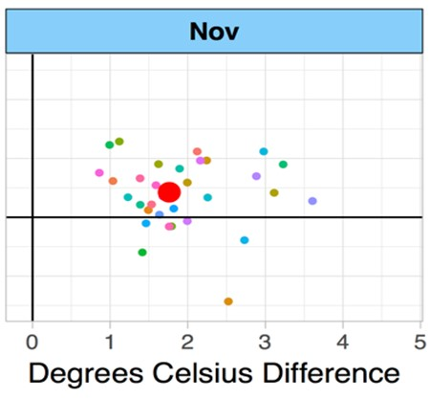
CBP Climate Analysis System
RCP selection
GCM Selection Process
Downscaling Method
Downscaling Method
Observed Trends
Creation of future climate scenarios
GCM selection
Used the same group of models and model runs that were used in NOAA’s Climate Resilience Toolkit
Precipitation Difference

Slide 15
CBP Climate Analysis System
RCP selection
GCM Selection Process
Downscaling Method
Downscaling Method
Observed Trends
Creation of future climate scenarios
Downscaling methods:
Bias Corrected Spatial Disaggregation (BCSD) - used for runs in 2017
Investigating Multivariate Adaptive Constructed Analogs (MACA)
Investigating Localized Constructed Analogs (LOCA)
Literature exists to support the idea that all are reasonable approaches

Slide 16
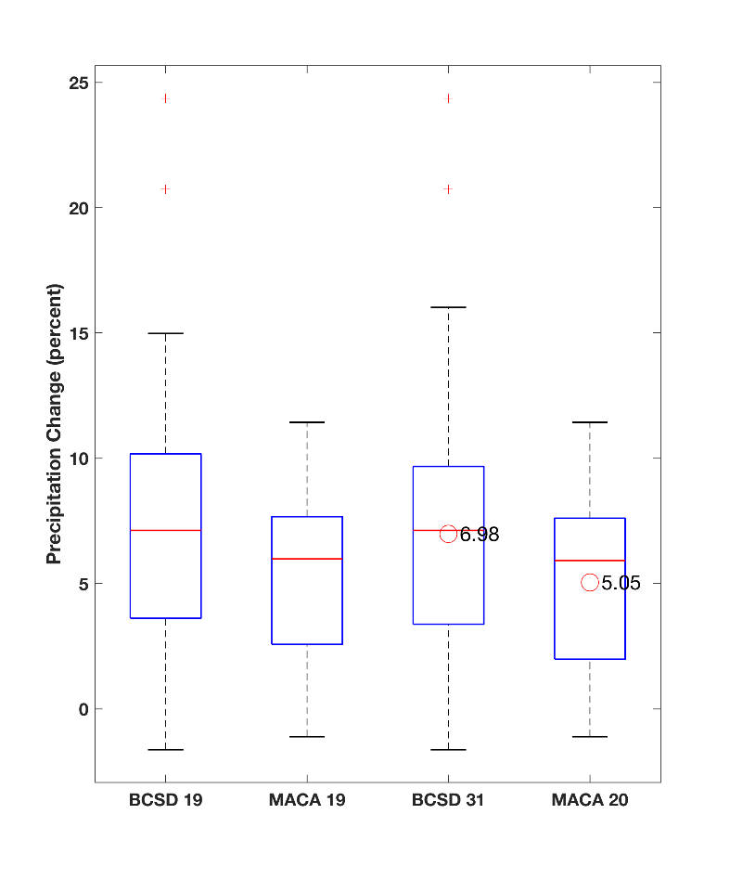
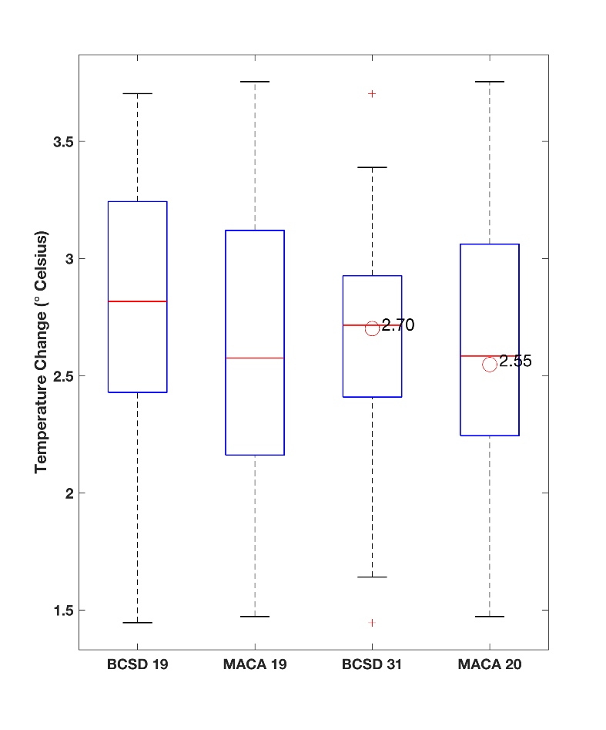
Summary of BCSD & MACA delta change
RCP 8.5
2050 vs. 1995
Precipitation Change (percent)
Temperature Change (Celsius)
BCSD
19 GCMs
MACA
19 GCMs
BCSD
31 GCMs
MACA
20 GCMs
BCSD
19 GCMs
MACA
19 GCMs
BCSD
31 GCMs
MACA
20 GCMs
Identical set of GCMs
Identical set of GCMs

Slide 17
RCP 8.5
2050 vs. 1995
1 to 1 line
Figure shows delta % change in annual rainfall volume from 19 matching GCMs after downscaling.
1 to 1 line
Figure shows delta degree Celsius change for temperature from 19 matching GCMs after downscaling.

Slide 18
Falls Church, VA – Rainfall
RCP 8.5
2050 vs. 1995

Slide 19
Falls Church, VA – Temperature
RCP 8.5
2050 vs. 1995

Slide 20
CBP Climate Analysis System
RCP selection
GCM Selection Process
Downscaling Method
Downscaling Method
Observed Trends
Creation of future climate scenarios
Ensemble Method
Used the median temperature and precipitation change from the ensemble for each month for the primary run.
Used the corners of the 90th percentile ‘box’ to investigate uncertainty
Precipitation Difference

Slide 21
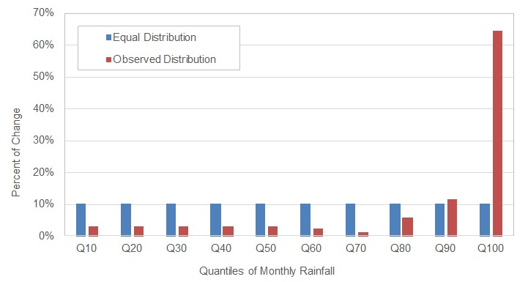
CBP Climate Analysis System
RCP selection
GCM Selection Process
Downscaling Method
Downscaling Method
Observed Trends
Creation of future climate scenarios
Literature shows that the increases in precipitation over the previous century have primarily occurred in the highest precipitation events.
Two methods of rainfall addition
Multiply all rainfall events by the same factor
Multiply rainfall events within a decile by a factor such that the top decile increases a greater percentage as shown

Slide 22
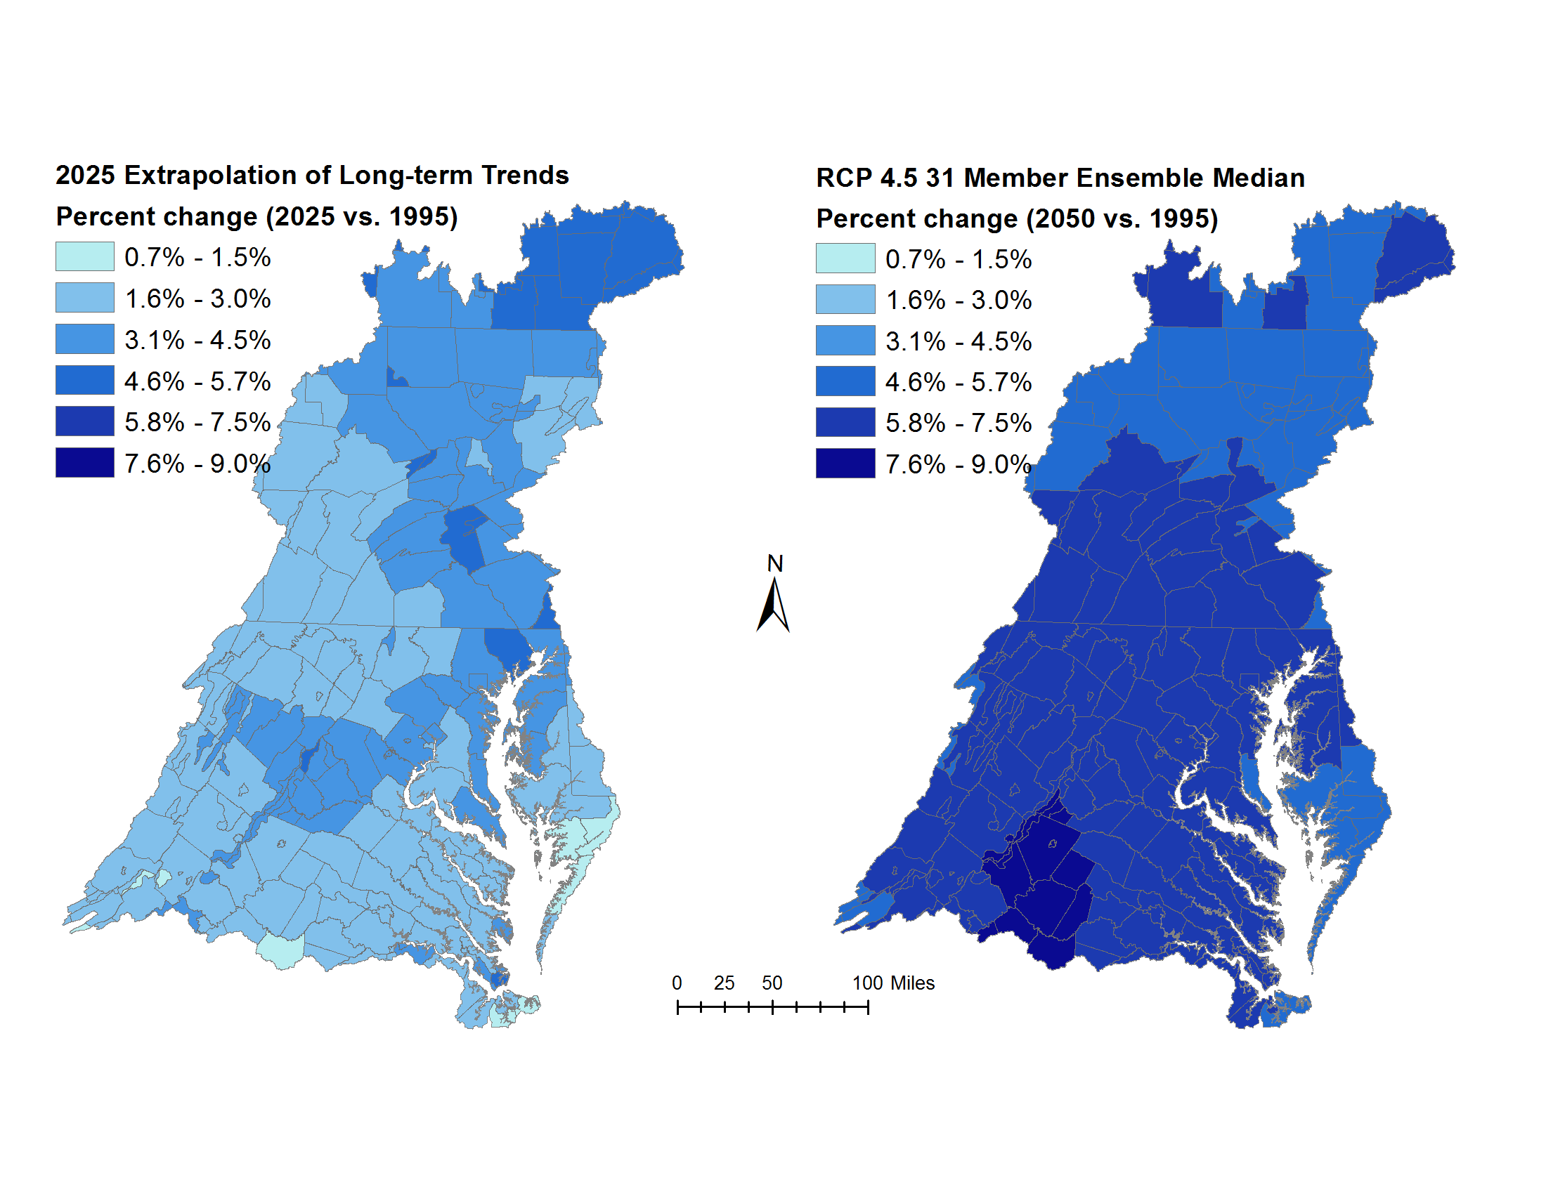
2017 Assessment
YEAR 2025
YEAR 2050
3.11% increase in average annual rainfall volume
6.28% increase in average annual rainfall volume

Slide 24
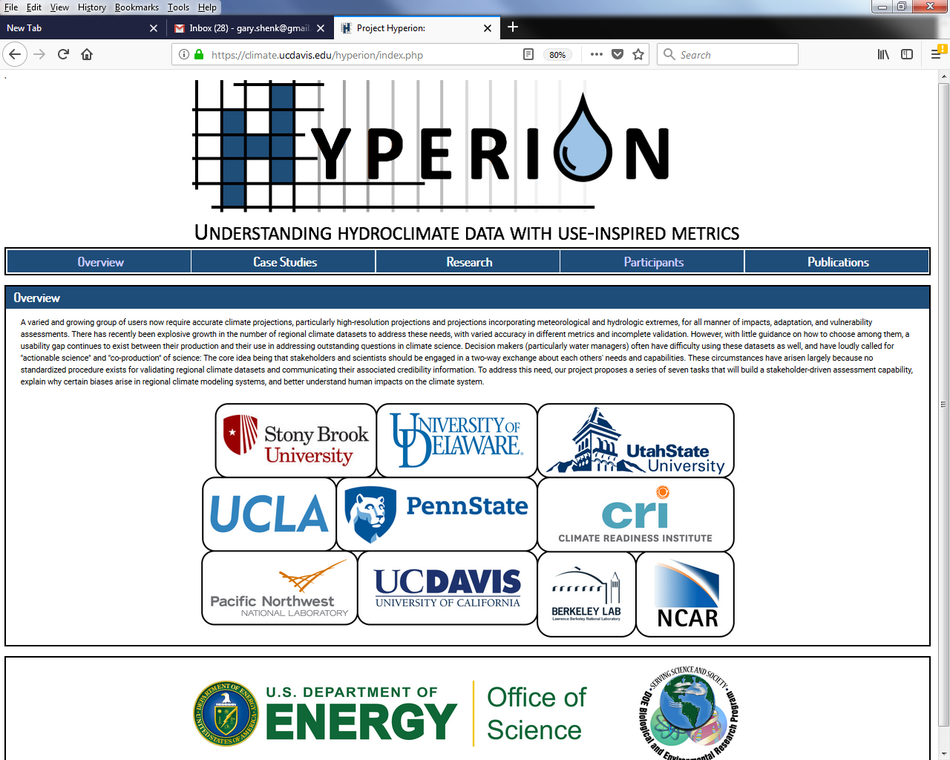

Slide 25
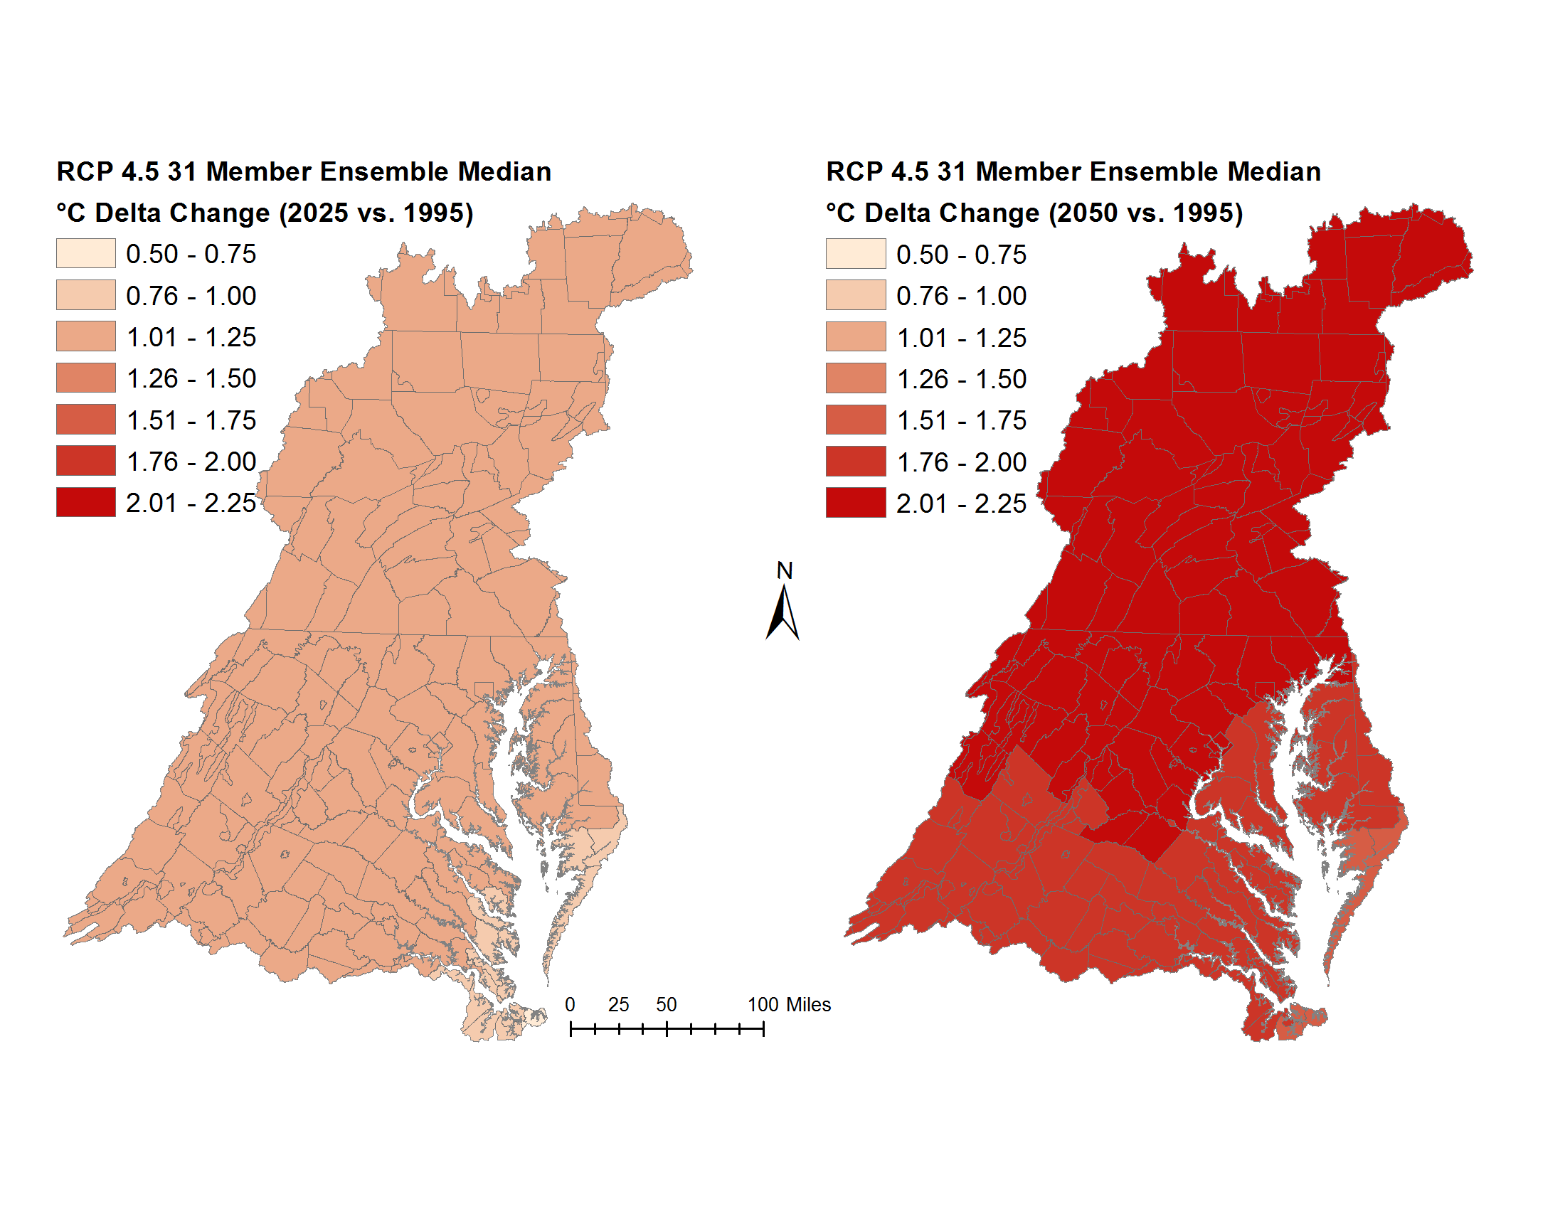
2017 Assessment
YEAR 2025
YEAR 2050
1.12°C increase in average annual temperature
2.03°C increase in average annual temperature

Slide 27
2017 Assessment
Estimation of potential evapotranspiration (PET)
Percent change in PET
The difference in PET using the Hamon and Hargreaves-Samani methods are shown. For 2025, the Hamon method estimated an increase in PET that was 3.36% greater than that from Hargreaves-Samani method. The change was even more pronounced for 2050, where PET estimated by Hamon method 6.26 percent greater than that from Hargreaves-Samani. Estimated change in PET using Penman Monteith (short reference) show better agreement with Hargreaves-Samani.

Slide 28
CBP Climate Analysis System
RCP selection
GCM Selection Process
Downscaling Method
Downscaling Method
Observed Trends
Creation of future climate scenarios
PET
Use Hargreaves-Samani to calculate change in PET
Function of temperature and extraterrestrial radiation
Apply the change in PET to the Base PET used in the Phase 6 model

Slide 29
CBP Climate Analysis System
Scenario selection
GCM Selection Process
Downscaling Method
Observed Trends
Creation of future climate scenarios
Process-based response of flow and sediment
Specified response to flow and sediment
Estuarine Process-based model
Effect on water quality standards
Management Effort Adjustment

Slide 30
CBP Climate Analysis System
Creation of future climate scenarios
Process-based response of flow and sediment
Specified response to flow and sediment

Slide 31
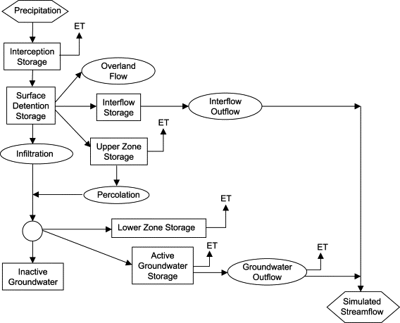
Creation of future climate scenarios
CBP Climate Analysis System
Process-based response of flow and sediment
Specified response to flow and sediment
HSPF simulation of hydrology is sensitive to:
Precipitation
PET
CO2
Temperature (snowfall and snowmelt)

Slide 32
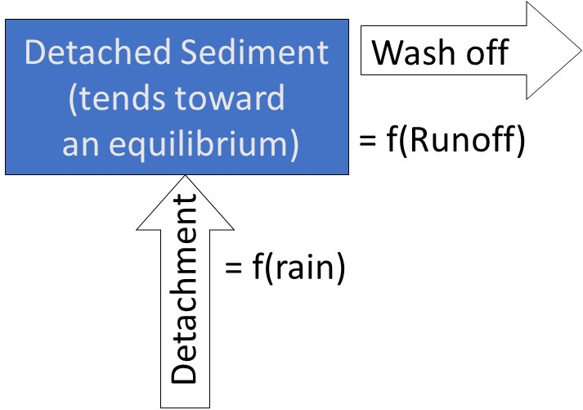
Creation of future climate scenarios
CBP Climate Analysis System
Process-based response of flow and sediment
Specified response to flow and sediment
HSPF simulation of sediment is sensitive to:
Precipitation
Runoff
PET, temperature, CO2, precip

Slide 33
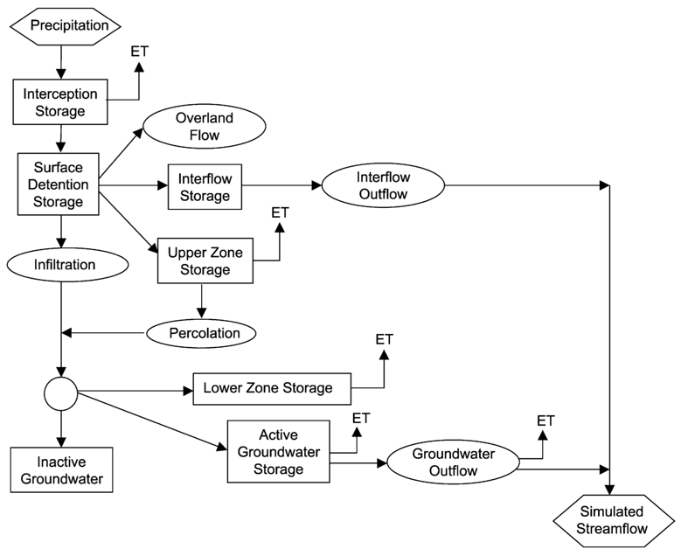
2017 Assessment
Summary of changes in delivery
Hydrologic response:
rainfall volume & intensity
snow and melt due to temperature
evapotranspiration
Flow
Year 2025
Trend rainfall and Ensemble median temperature
Year 2050
Ensemble median rainfall & temperature
Johnson et al. 2003
Sediment
Sediment response:
rainfall intensity
surface runoff
riverine scour and deposition
Year 2025
Trend rainfall and Ensemble median temperature
Year 2050
Ensemble median rainfall & temperature
Trend: projection of extrapolation of long-term trends
Ensemble: 31-member ensemble of RCP4.5 GCMs
Bicknell et al. 2005

Slide 34
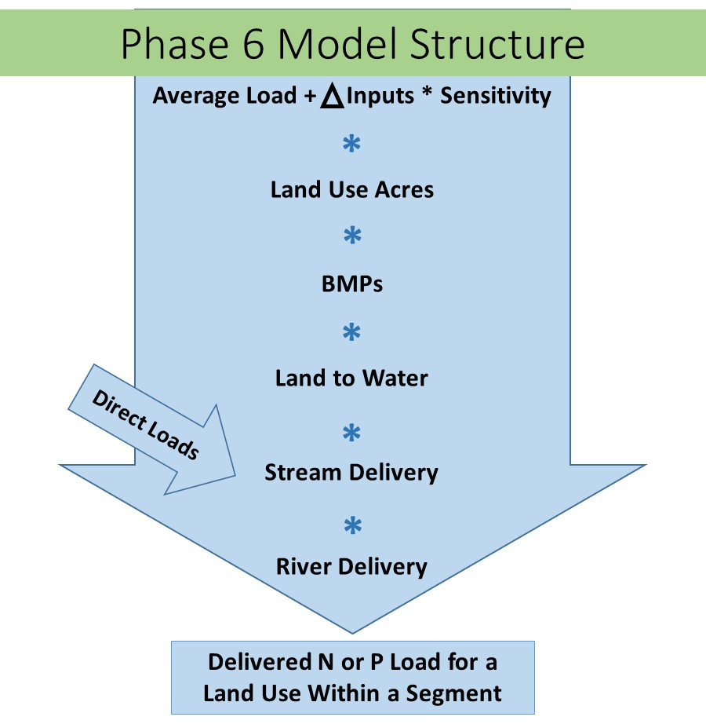
Creation of future climate scenarios
CBP Climate Analysis System
Process-based response of flow and sediment
Specified response to flow and sediment
Phase 6 model is time-averaged for N and P from the land
Sensitivity to climate must be specified

Slide 35
Creation of future climate scenarios
CBP Climate Analysis System
Process-based response of flow and sediment
Specified response to flow and sediment
Nitrogen Sensitivities
Agriculture
Fertilizer
Manure
Atmospheric Deposition
Fixation
Crop Cover
Uptake
Nitrogen Sensitivities
Developed
Fertilizer
Atmospheric Deposition
Crop Cover
Uptake
Natural
Atmospheric Deposition
Delivery
Available water capacity
Groundwater recharge
Piedmont carbonate

Slide 36
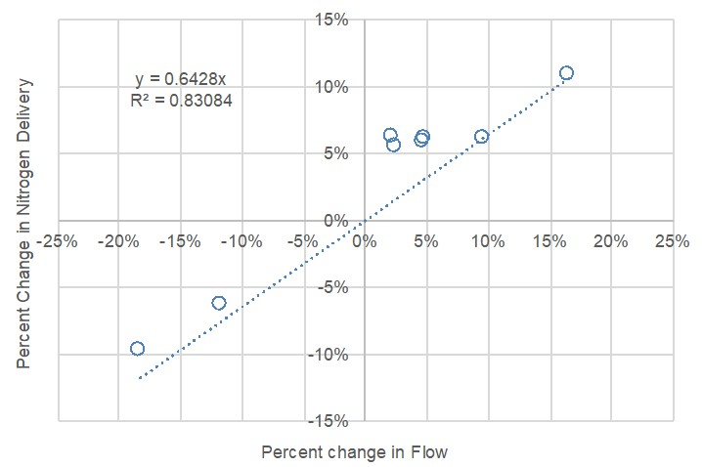
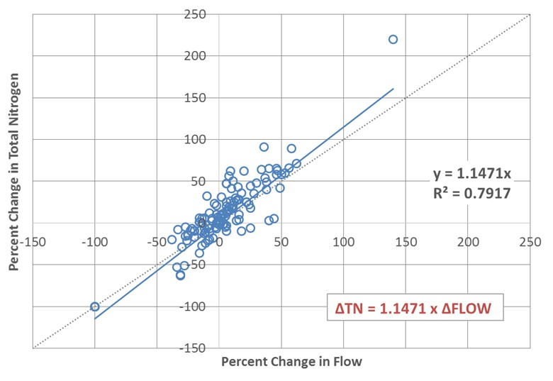
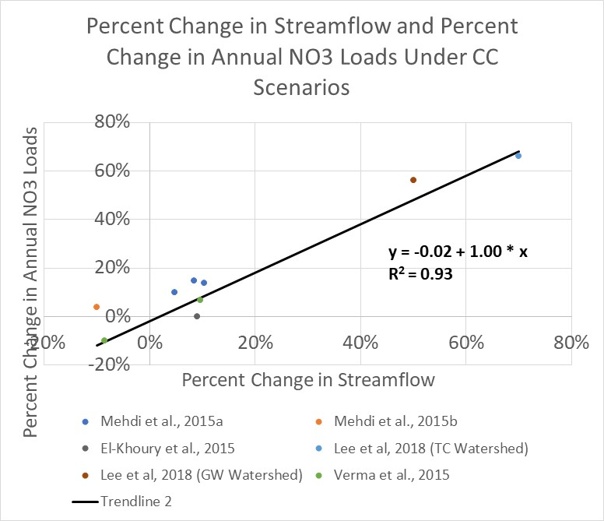
Creation of future climate scenarios
CBP Climate Analysis System
Process-based response of flow and sediment
Specified response to flow and sediment
Nitrogen assumption:
No changes to the concentrations
proportional change in load to a change in flow.
Phase 5.3.2
Nitrogen change = 64% of flow change
‘20 watersheds’ study
Nitrogen change = 115% of flow change
CBPO literature review
Nitrate change = 100% of flow change

Slide 37
Creation of future climate scenarios
CBP Climate Analysis System
Process-based response of flow and sediment
Specified response to flow and sediment
Phosphorus Sensitivities
Agriculture
Soil P
Applied Water Extractable P
Stormflow
Sediment Washoff
Developed
Fertilizer
Natural
Stormflow
Sediment Washoff
Delivery
Well-drained soils

Slide 38

2017 Assessment
Summary of changes in delivery
Nitrogen response:
sensitivity to flow
stream bank erosion
denitrification, organic scour
Nitrogen
Year 2025
Trend rainfall and Ensemble median temperature
Year 2050
Ensemble median rainfall & temperature
Shenk G.
Phosphorus
Phosphorus response:
sensitivities to flow and sediment (APLE)
stream bank erosion
scour/deposition of inorganic and organic (HSPF)
Year 2025
Trend rainfall and Ensemble median temperature
Year 2050
Ensemble median rainfall & temperature
Trend: projection of extrapolation of long-term trends
Ensemble: 31-member ensemble of RCP4.5 GCMs

Slide 39
2017 Assessment
Nitrogen and phosphorus species
Simulated changes in nitrogen delivery
Simulated changes in phosphorus delivery
Year 2025
Trend rainfall and Ensemble median temperature
Year 2050
Ensemble median rainfall & temperature
Year 2025
Trend rainfall and Ensemble median temperature
Year 2050
Ensemble median rainfall & temperature
Arrows show relatively more increase in organic nitrogen as compared to inorganic.
Arrows show relatively more increase in particulate phosphorus as compared to dissolved inorganic phosphorus.
Trend: projection of extrapolation of long-term trends
Ensemble: 31-member ensemble of RCP4.5 GCMs

Slide 40
CBP Climate Analysis System
RCP selection
GCM Selection Process
Downscaling Method
Observed Trends
Creation of future climate scenarios
Human responses to climate change
Process-based response of flow and sediment
Specified response to flow and sediment
Estuarine Process-based model
Effect on water quality standards
Management Effort Adjustment

Slide 41
Human responses to climate change
CBP Climate Analysis System
Sensitivities are built in, but need to know how they change in response to human actions
Nitrogen Sensitivities
Agriculture
Fertilizer
Manure
Atmospheric Deposition
Fixation
Crop Cover
Uptake
Nitrogen Sensitivities
Developed
Fertilizer
Atmospheric Deposition
Crop Cover
Uptake
Natural
Atmospheric Deposition
Phosphorus Sensitivities
Agriculture
Soil P
Applied Water Extractable P
Stormflow
Sediment Washoff
Developed
Fertilizer
Natural
Stormflow
Sediment Washoff

Slide 42
CBP Climate Analysis System
RCP selection
GCM Selection Process
Downscaling Method
Observed Trends
Creation of future climate scenarios
Human responses to climate change
Process-based response of flow and sediment
Specified response to flow and sediment
Estuarine Process-based model
Effect on water quality standards
Management Effort Adjustment

Slide 43
December 2017
Relative Sea Level Rise
CRWG:
2025 17cm
Interpolate between 2025 and 2050
2050 = 50cm for now
Extreme (2.5m)
High Emission Scenario with
Max Contribution from Ice Sheets;
Low Probability, High Consequences
High (2.0m)
Intermediate High (1.5m)
Moderate to High Emissions
Intermediate (1.0m)
Intermediate Low (0.5m)
Low Emissions; Requires
Major Carbon Cuts and Removal
Low (0.3m)
The six Global Mean Sea Level (GMSL) scenarios in Sweet et al., 2017, identified by the height in meters in 2100 relative to MSL in 2000, span the range of scientifically plausible sea level rise scenarios. The shaded regions represent a central 80% probability range for each scenario. These curves have been adjusted to depict MSL relative to 1992.
The five scenarios described in Hall et al., 2016 correspond to GMSL of 2.0m, 1.5m, 1.0m, 0.5m, and 0.2m relative to MSL in 1992, and are indicated by thick black lines.
Graphic by E.T. Petruncio
Relative Sea Level Rise Scenarios for Annapolis
with Annapolis Monthly Mean Sea Level Data for 1930-2016
Sources: Hall et al. (2016) and Sweet et al. (2017)
Notes:
MSL in 2000 = MSL in 1992 + .092957 ft (based on averages of monthly data)

Slide 44
CBP Climate Work Plan
2018
STAC Workshop
2019
Water Quality GIT, Modeling WG, Climate Resiliency WQ direct Modeling team to develop climate change assessment for TMDL
2020
Technical Review of Models
2021
Climate change considerations will be implemented into the 2022-2023 milestones.
Jurisdictions provide narrative in WIP3s on climate strategies
Modeling WG develop climate scenarios
Climate Resiliency WG to investigate BMP response
Notes:
See Attachment 1 in your materials
Arrow indicates where we are today
Circle show a key deliverable, the revised assessment.

